Slide 1
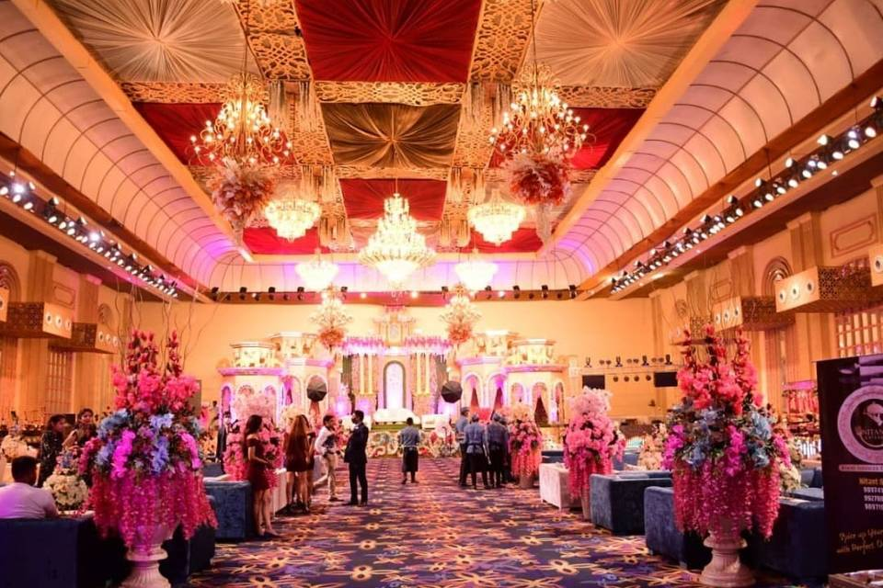
Marriage Hall Booking Application
Presented by – Pranjal Srivastava
Rishabh Varshney
Shabdansh yadav
Shardindu
Saksham Mishra

Slide 2
Contents
1- Abstract
2- Introduction
3- System Requirement
4- Modules
5- Services
6- Technology used
7- Design and ER diagram
8- Dockerize our application
9- Deploy application images using AWS EKS , ECS, RDS services
10- Advantages
11- Disadvantages
12- Conclusion

Slide 3
Abstract
The purpose of marriage hall booking application is to automate the existing manual system by help of computerised equipment and computer software fulfilling there requirements so that the valuable data of customer can be stored for a longer duration of time and with easy accessing.
This system allows the real time communication between admin and user. This system allows user to login into the application using there email id and get information like venue details, seating capacity of a marriage hall, cuisine, music system available, etc.
The main purpose of this application is to manage booking information among various aspects. The interaction of spring tool suite marriage hall booking application has been implemented using spring tool suite-4.1.5 release, POSTMAN, PostgreSQL, Amazon web services.

Slide 4
Introduction
In earlier times the marriage hall booking was done manually and it was a very hectic task as the customer have to book hall and catering separately and which cost him a lot of amount and still don’t get desired service.
Online marriage hall booking application allows user to book marriage venue, cuisine, no. of seats, music, etc. at a single platform. The user have to pay to a single vendor and can avail all the facilities.
As a user:-
1- You can book a venue. 2- Look at number of seats available. 3- You can decide music, cuisine. 4- You can confirm your booking.

Slide 5
System Requirement
Operating System : Windows 10
Programming Language : Spring Boot , REST service , Spring Data JPA , REST API
Database : POSTGRESQL
Docker
Kubernetes
POSTMAN

Slide 6
Modules
Entity – (a) Booking : It includes details of marriage hall (b) Customer : It includes details of customer
Repository – (a) Booking repository (b) Customer repository
Request – (a) Booking request (b) Order response
Controller – (a) Booking controller

Slide 7
Services
Admin Vendor Service to add, delete, update and list available vendors
Admin Supervisor Service to add, delete , update and list available supervisors/managers
Booking service : This service is to the customer for booking the hall with his preferences
Supervisor Service can provides with all services with details like Venue details , Electrical equipment details, Dining details, housekeeping details, pricing and billing etc
Vendor Service : This service can provide various facility with costing like catering, flower decors, music systems, Video coverage etc.
Customer : Can have a preference to search for Hall with preferences city,Location, Date and Timing

Slide 8
Technology Used
Java 11
Postgres
Postman
Spring Boot
Docker
Kubernetes
AWS EC2

Slide 9
Design

Slide 10
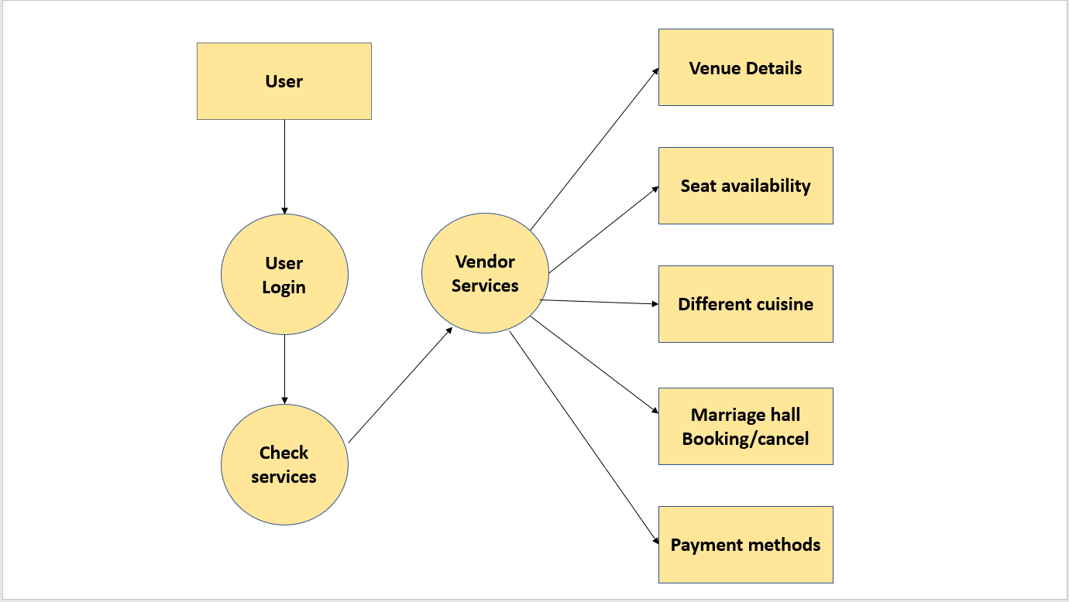
Design

Slide 11
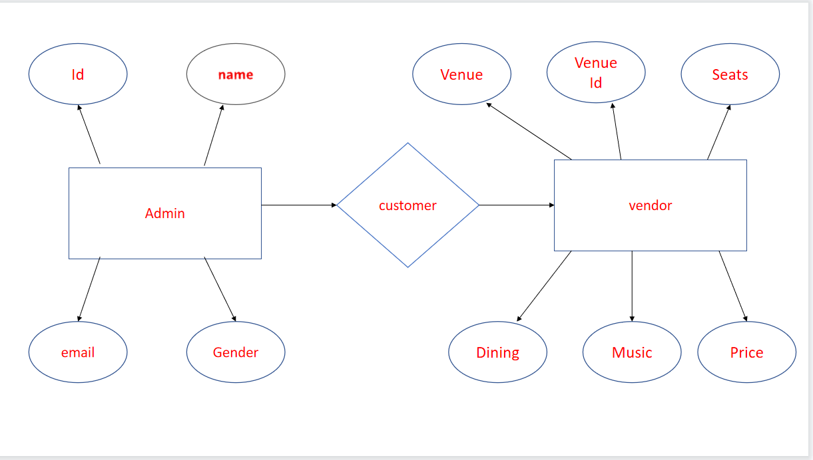
ER Diagram

Slide 12
Deployment
Dockerize marriage hall booking application by Using Docker-Compose
Push the code into github by using Gitbash.
Create EC2 instance in AWS.
Connect EC2 instance with cmd.
Clone our code by using git clone "url name“
Change your command directory to that exact source code.
Install MAVEN by using sudo apt install maven
Give command mvn clean install/mvn clean install –DskipTests
Install Docker by using sudo apt install docker.io
To build docker images give sudo docker build -t imagename:tagname .
Perform Docker login sudo docker login used for login our docker repository.
Push docker images to your docker hub repository by using sudo docker push imagename

Slide 13
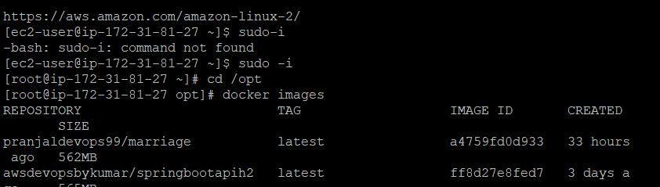
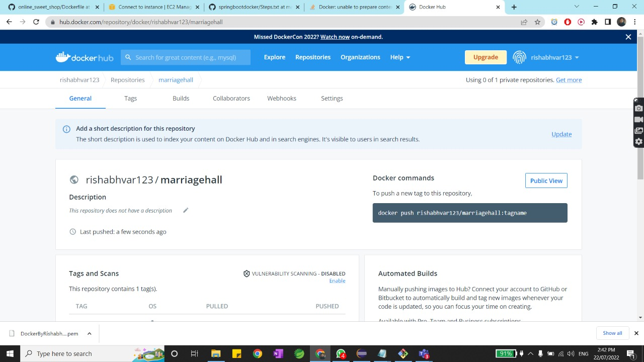

Slide 14
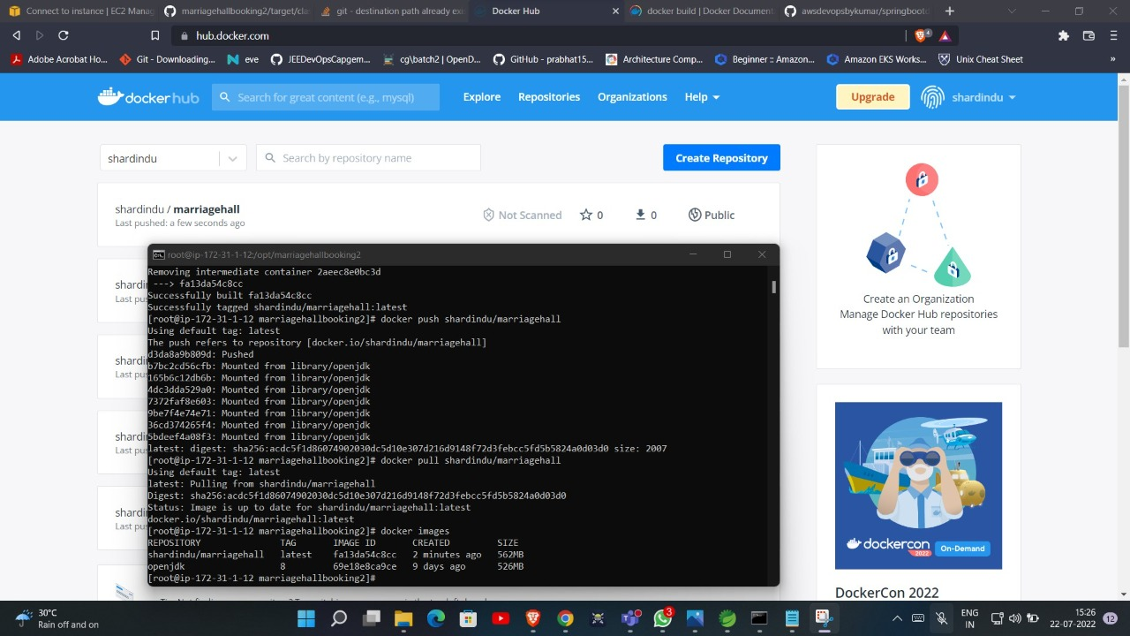

Slide 15
Deployment
We can use Kubernetes for deployment purpose also
First create two EC2 instances one for master node and other for worker node
1 hostnamectl set-hostname master
2 exit
3 kubeadm init //Run this command in order to set up the Kubernetes control plane
4 mkdir -p $HOME/.kube
5 sudo cp -i /etc/kubernetes/admin.conf $HOME/.kube/config
6 sudo chown $(id -u):$(id -g) $HOME/.kube/config
7 kubectl get nodes
8 kubectl get pods --all-namespaces
9 kubectl apply -f https://aws-quickstart.s3.amazonaws.com/quickstart-vmware/scripts/weave.yaml
10 kubectl get pods --all-namespaces

Slide 16
11 kubectl get nodes
12 docker pull rishabhvar123/marriagehall
13 docker images
14 vi dep.yml
15 kubectl create -f dep.yaml
17 kubectl get pods
18 vi service.yaml
19 kubectl create -f service.yml
20 kubectl create -f service.yaml
21 kubectl get service
22 kubectl get service -o wide

Slide 17
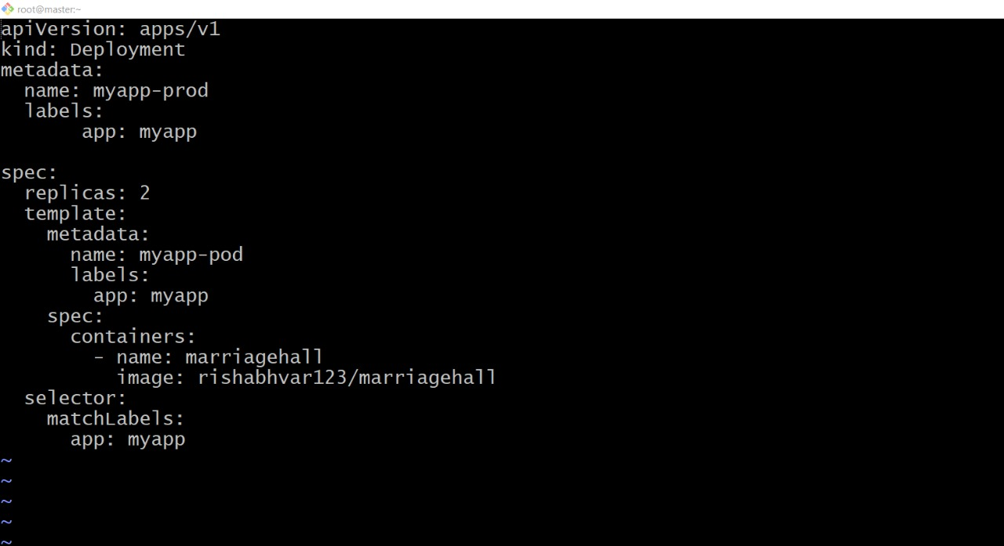

Slide 18
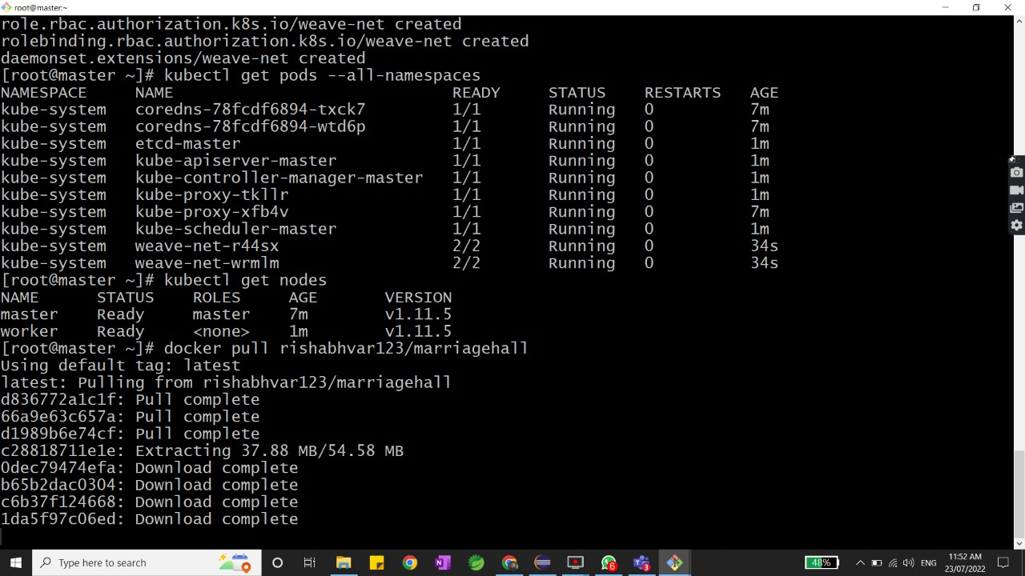

Slide 19
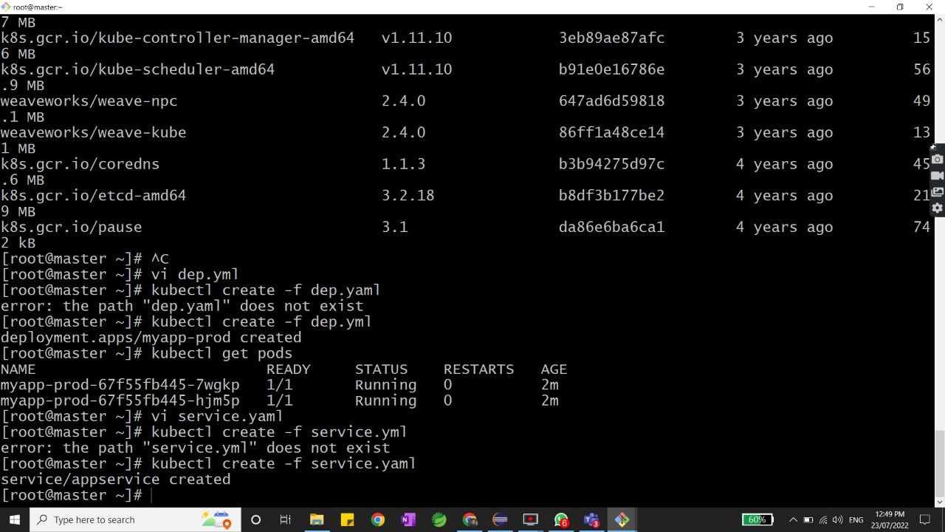

Slide 20
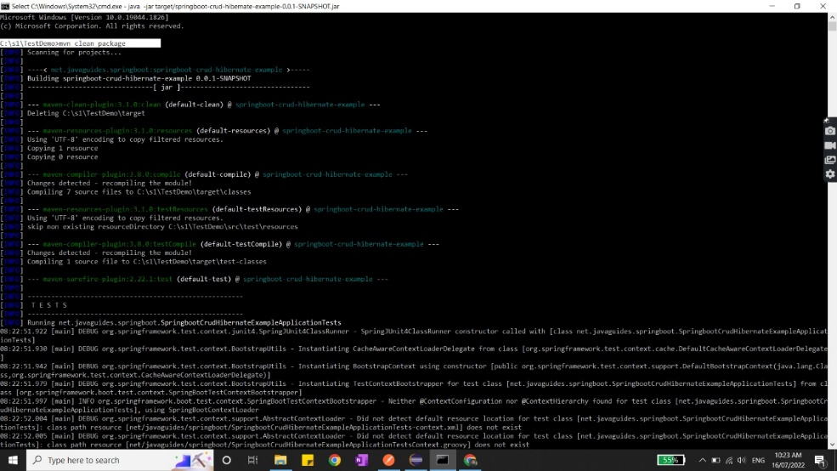
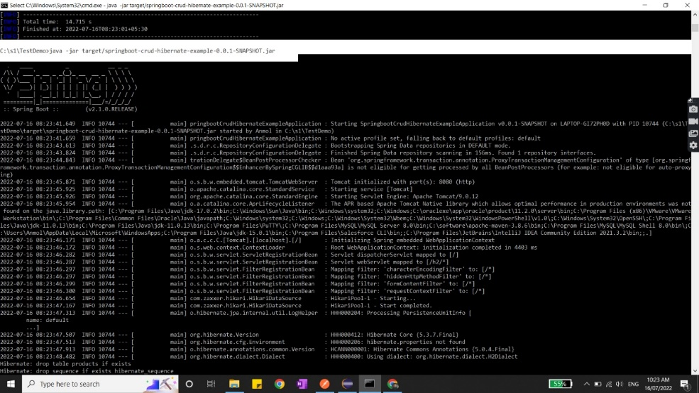
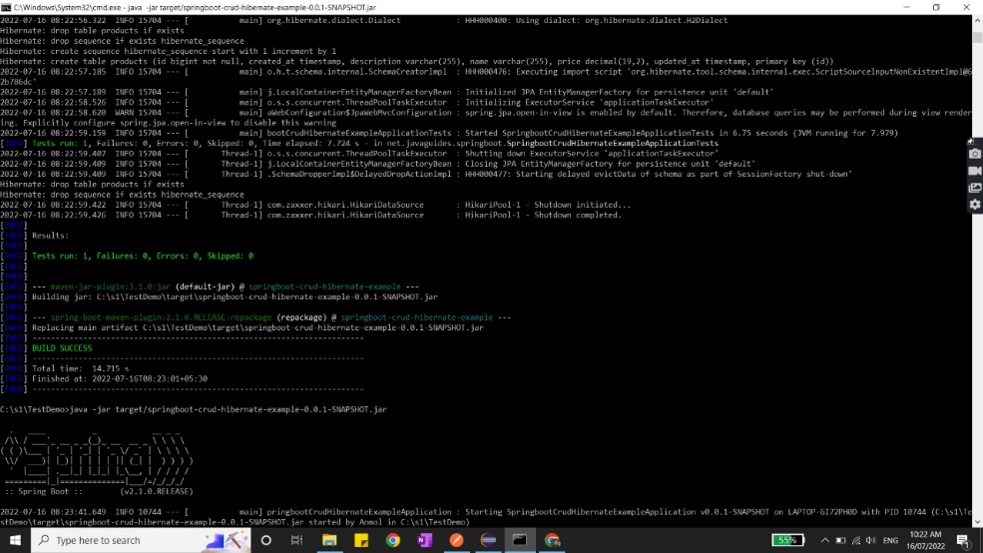
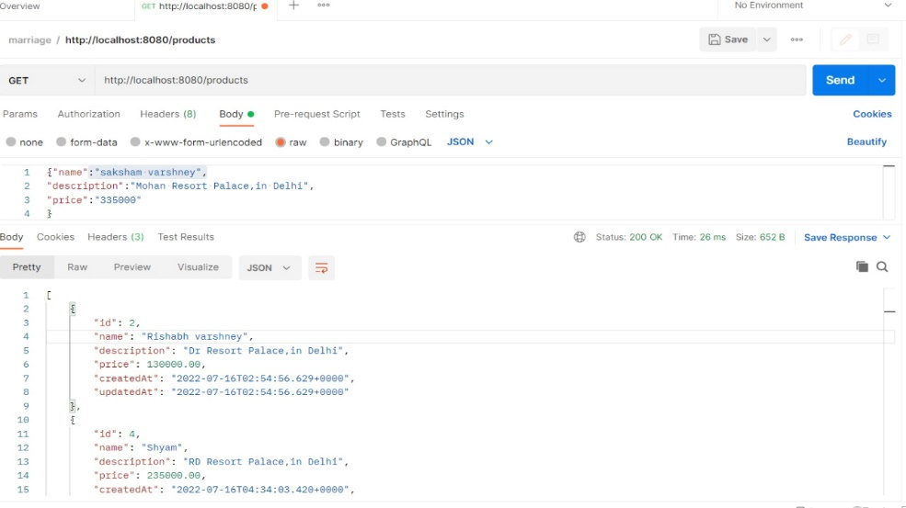
Output

Slide 21
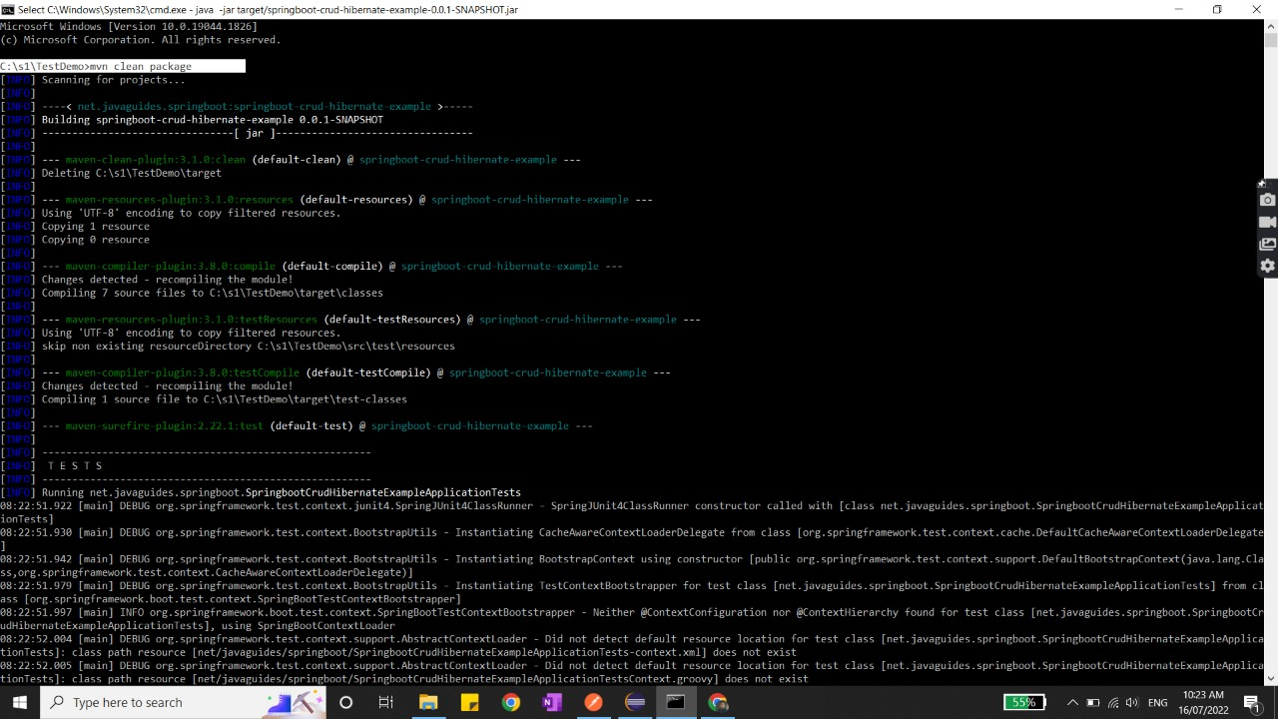
Command: mvn clean package

Slide 22
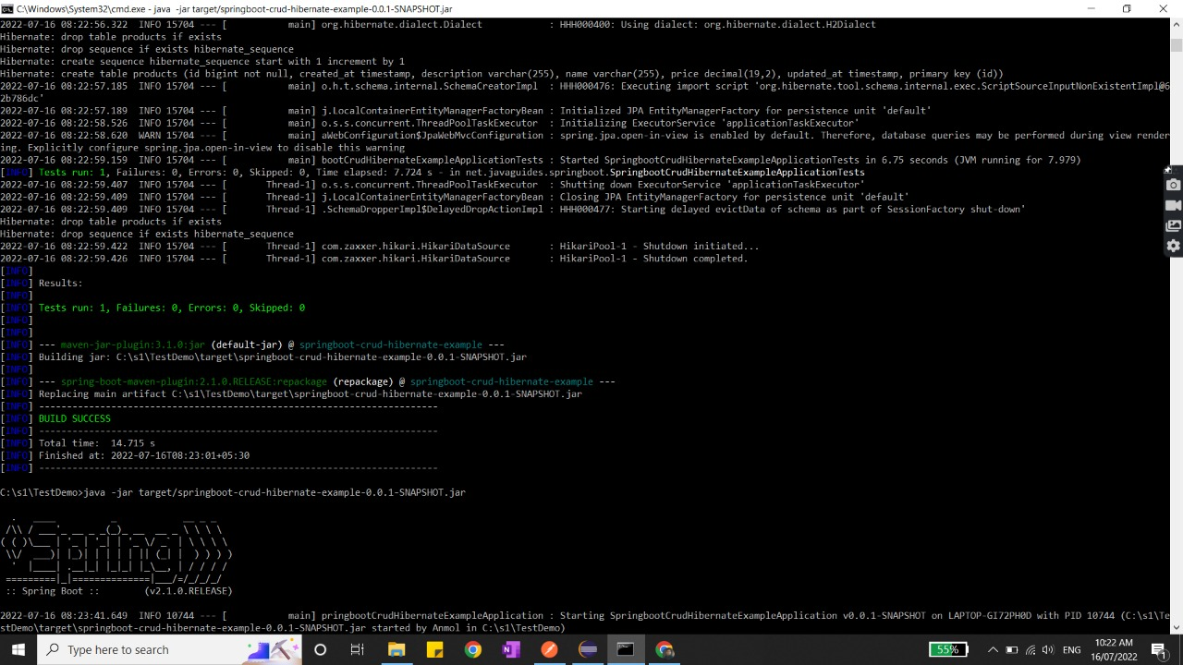

Slide 23

Command: java –jar target/springboot-crud-hibernate-example-0.0.1-SNAPSHOT.jar

Slide 24
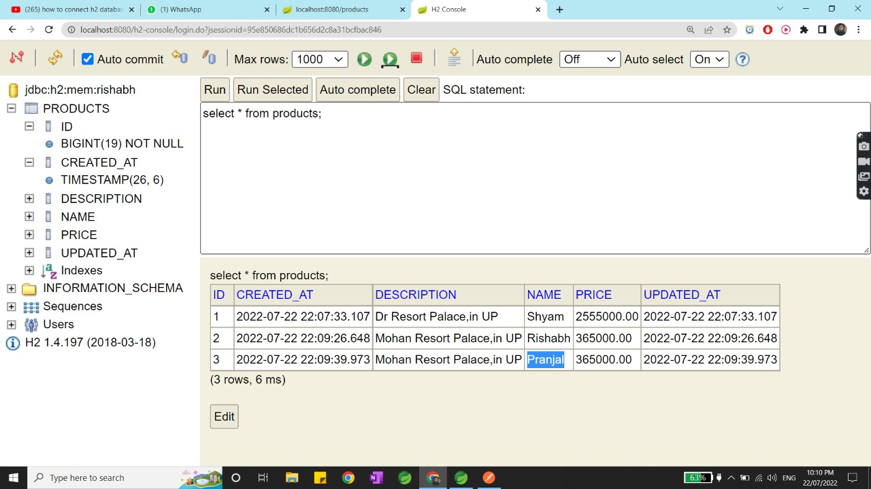

Slide 25
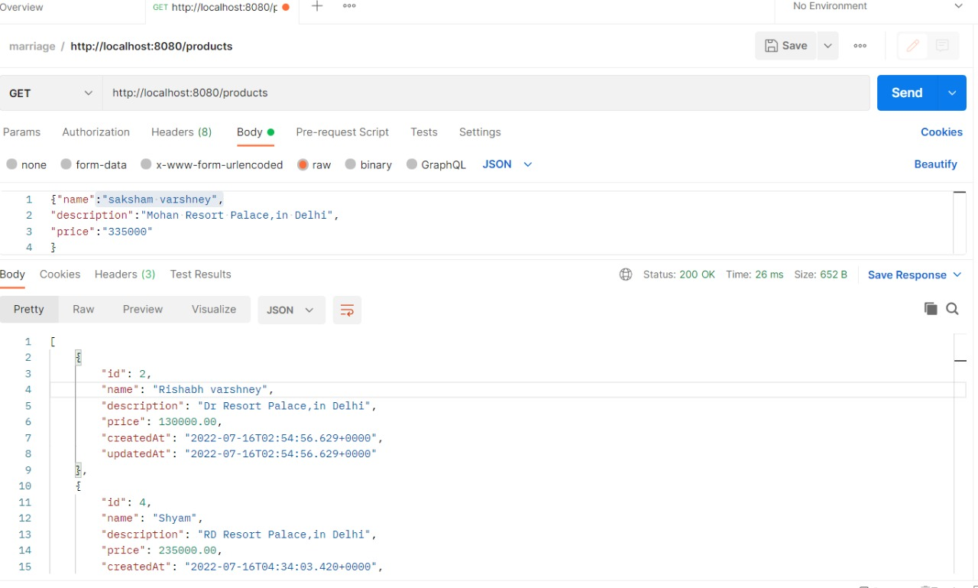
Postman output

Slide 26
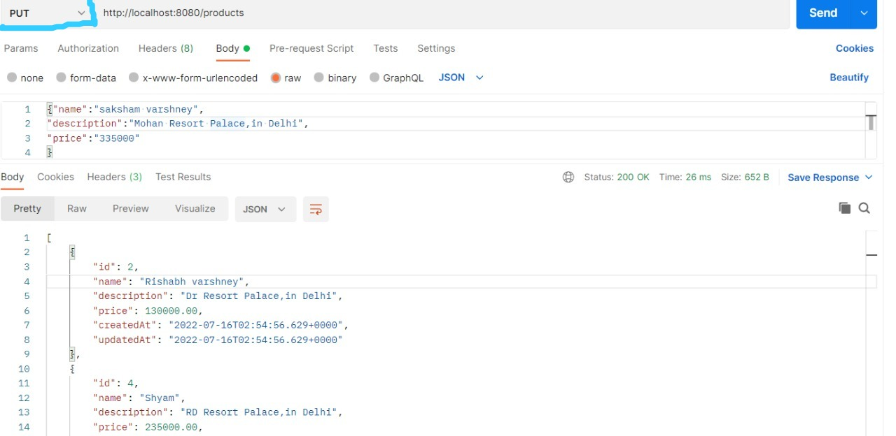

Slide 27
Conclusion
The purpose of marriage hall booking application is to automate the existing manual system by help of computerised equipment and computer software fulfilling there requirements so that the valuable data of customer can be stored for a longer duration of time and with easy accessing.
We have provided many different options to user so that he can book an ideal marriage hall according to his needs and can get all the services he requires.
A lot of research work has been done to find best method to develop this application.
We have tried to make this project user friendly and also tried to provide many features to it.
A lot of research work has been done and we are looking forward for any technology that can improve this project.

Slide 28
THANK YOU

